Slide 1

Section 2. Practical tips for writing your applied paper
Style, tone, length, and grammar

Slide 2
What type of journal are you targeting?
Economics and, for instance, medical journals have distinctive styles

Slide 3

Media attention and Vaccine Hesitancy: Examining the mediating effects of Fear of COVID-19 and the moderating role of Trust in leadership
Lulin Zhou,Sabina Ampon-Wireko, Xinglong Xu, Prince Edwudzie Quansah, and Ebenezer Larnyo
Published: February 18, 2022 https://doi.org/10.1371/journal.pone.0263610
The current study, therefore, hypothesized that; H1: Media attention has a significant influence on COVID-19 vaccine hesitancy. H2: Media attention significantly influences fear of COVID-19 positively.

Slide 4
I see manuscripts submitted to the Journal of Policy Analysis and Management (JPAM) with this type of phrasing all the time. I imagine that some policy journals publish papers that use this type of phrasing, but JPAM, as a general rule, does not.
The current study, therefore, hypothesized that; H1: Media attention has a significant influence on COVID-19 vaccine hesitancy. H2: Media attention significantly influences fear of COVID-19 positively.

Slide 5
I see manuscripts submitted to the Journal of Policy Analysis and Management (JPAM) with this type of phrasing all the time. I imagine that some policy journals publish papers that use this type of phrasing, but JPAM, as a general rule, does not.
Written in past tense and third person
The current study, therefore, hypothesized that; H1: Media attention has a significant influence on COVID-19 vaccine hesitancy. H2: Media attention significantly influences fear of COVID-19 positively.

Slide 6
I see manuscripts submitted to the Journal of Policy Analysis and Management (JPAM) with this type of phrasing all the time. I imagine that some policy journals publish papers that use this type of phrasing, but JPAM, as a general rule, does not.
The current study, therefore, hypothesized that; H1: Media attention has a significant influence on COVID-19 vaccine hesitancy. H2: Media attention significantly influences fear of COVID-19 positively.
Conflates statistical significance and importance

Slide 7
Style, Tone, Length and Grammar
What type of journal are you targeting?
Economics and, for instance, medical journals have distinctive styles
Let’s imagine that you’re targeting an economics journal
Within economics, journals have distinctive styles
Read a few articles in the journal that you’re targeting
Let’s imagine that you’re targeting a field journal such as the Journal of Health Economics, Labour Economics, or the Journal of Public Economics

Slide 8
Style and Tone
Engaging without being chatty or informal
More formal than the language you hear being used in seminars
Avoid “get” and “got”
Avoid using contractions (e.g., won’t, don’t, can’t, shouldn’t)
Avoid this construction:
“…we use for our main calibration the value 0.38, i.e. the median of the elasticity estimates in the literature.”

Slide 9
Style and Tone
Engaging without being chatty or informal
More formal than the language you hear being used in seminars
Avoid “get” and “got”
Avoid using contractions (e.g., won’t, don’t, can’t, shouldn’t)
Avoid this construction:
“…we use for our main calibration the value 0.38, i.e. the median of the elasticity estimates in the literature.”
“…we use for our main calibration the value 0.38 (i.e., the median of the elasticity estimates in the literature).”
Please note the comma
I much prefer this construction

Slide 10
Read what you’ve written out loud
Does each sentence set up the next?
Does each paragraph set up the next?
Don’t reinvent the wheel
Read some classics. How did Charles and Guryan (2008) begin their introduction? What are they doing in their first paragraph? In their second paragraph?
Style and Tone

Slide 11
Read what you’ve written out loud
Does each sentence set up the next?
Does each paragraph set up the next?
Don’t reinvent the wheel
Read some classics. How did Charles and Guryan (2008) begin their introduction? What are they doing in their first paragraph? In their second paragraph?
Style and Tone
The language you use in a seminar is more informal! Don’t use exclamation points!

Slide 12

Introduction
Becker’s (1957) seminal The Economics of Discrimination launched the formal analysis of labor market discrimination among economists. Becker’s analysis focused on the relationship between racial prejudice among whites and discrimination against racial minorities in a competitive model. In contrast to much of the contemporaneous literature, Becker formalized the definition of racial preferences…

Slide 13
Introduction
Becker’s (1957) seminal The Economics of Discrimination launched the formal analysis of labor market discrimination among economists. Becker’s analysis focused on the relationship between racial prejudice among whites and discrimination against racial minorities in a competitive model. In contrast to much of the contemporaneous literature, Becker formalized the definition of racial preferences…
In the short-run version of Becker’s employer discrimination model,
racial prejudice causes some employers to regard black workers as more expensive than they truly are. Market pressures cause blacks to be hired by the least prejudiced employers in the market and to sort away from those with the highest levels of prejudice…Racial wage gaps…will generally be determined by variation in the level of prejudice of those in the lower tail of the prejudice distribution; how prejudiced the most prejudiced employers are should not matter at all for wages in Becker’s framework. Finally,…equilibrium wages for blacks should vary negatively with the number of blacks in the market…

Slide 14
Introduction
Background
Data Summary
Empirical Strategy
Results
Conclusion
I’d call this the “classic” way to structure an economics paper

Slide 15
Length
Aim for 18-23 pages of text, 5-6 figures and tables (combined total)
More figures than tables
Extra tables and figures can go in an appendix
The revision process is usually going to add text, tables, and figures
Thirty pages of text and 10 figures/tables is too much! Referees and editors have short attention spans.

Slide 16
Grammar
Pay someone to read you paper over for typos and grammatical errors
Make sure there is a one-to-one correspondence between in-text citations and references
Use a consistent style for the references
Include the first names of the authors. The editor is looking at your references for potential referees.

Slide 17
Q&A (≈ 10 minutes) + Break (≈ 5 minutes)

Slide 18
Section 2. Practical tips for writing
Producing effective tables
Tips for describing regression results
Thinking about statistical significance and magnitude

Slide 19
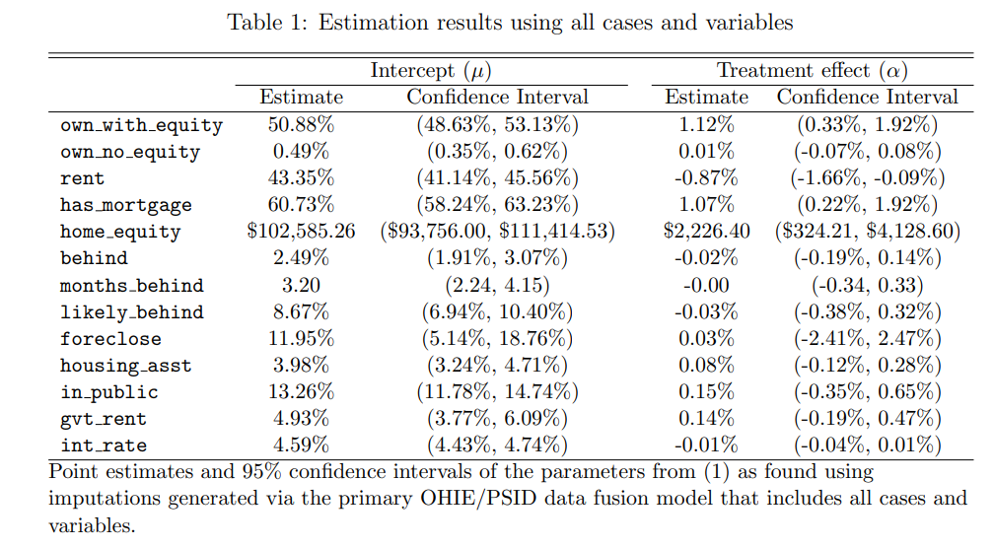
This table is from a recent submission to a top field journal. What can be improved?

Slide 20
The title could be much more informative. Must read the paper to understand what the authors are doing.
Variable names are directly from Stata program. Were they cut and pasted from the Stata output?

Slide 21
In general, the table is too cluttered. There is too much going on...
Measure in 1000s of $s.
I don’t need to know the effect down to the penny
What is the treatment? Use the notes to provide some sense of what is being estimated and how.

Slide 22
Period here instead of colon
Table 1. Years of schooling and hourly wages: Sample restricted to Danish respondents
 | Men Women wages ln(wages) wages ln(wages)
Schooling | 5.64 .054* (5.11) (.030) | 7.83** .094*** (3.55) (.007)
Observations | 12,385 | 12,012
Notes: The sample is restricted to Danish CHAT respondents ages 25-45 whose wage was greater than or equal to $3.25 per hour. Each column reports an estimate from a separate OLS regression of wages on years of schooling. Controls include race, ethnicity, marital status, union status, years of experience, tenure at current job, and firm size. Standard errors clustered at the state level are reported in parentheses. * Statistically significant at the 10% level; ** at the 5% level; *** at the 1% level.
Keep the table uncluttered. Don’t report the estimated coefficients of the controls.
Ideally, you provide enough information in the notes to the table so that the reader can interpret the estimates without having to read the text.
Now you can use a colon here

Slide 23
Useful Phrases When Describing Regression Results
I find evidence of a negative relationship between years of schooling and earnings.
The results suggest that schooling is negatively related to earnings.
Consistent with the hypothesis that educational attainment affects earnings, I find that...
A one-year increase in schooling is associated with a 6.8 percent increase in earnings.
The estimate of β is .068, suggesting that an additional year of schooling leads to a 6.8 percent increase in earnings.
The estimated effect of an additional year of schooling on earnings is positive 6.8 percent.

Slide 24
Describing Regression Results
Be clear about the units
Don’t confuse “percent” and “percentage”
Don’t focus on statistical significance
Do your best to characterize magnitude

Slide 25
Table 1. Estimates of the relationship between the unemployment rate and the probability of being vaccinated
 | Vaccinated Vaccinated
Unemployment rate | .00005 (.0006) | .005 (.002)
State FEs Mean of the DV Observations | no .266 12,385 | yes .266 12,012
Notes: Each column reports an estimate from a separate OLS regression of vaccination status (0/1) on years of schooling . Controls include race, ethnicity, marital status, union status, years of experience, tenure at current job, and firm size. Standard errors clustered at the state level are reported in parentheses.
Don’t report “0.000”
I’ve even seen 0.000***
If the unemployment rate goes from 10 to 11 percent, that’s a one percentage point increase in the unemployment rate.

Slide 26
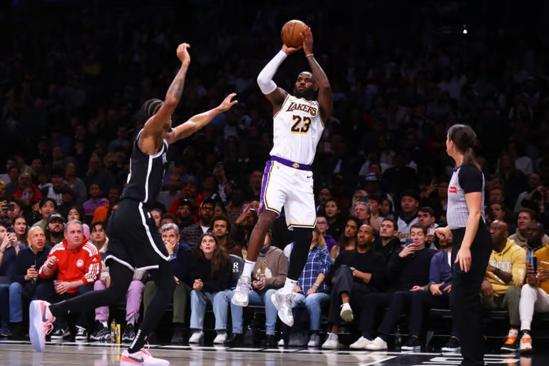
Lakers’ LeBron James on his NBA future after win over Nets: ‘I don’t have much time left’

Slide 27
What’s wrong with this sentence?
In his 21st season, James is inexplicably shooting a career-best 41.6 percent on 3s — one percent higher than his previous career-high mark (40.6 percent in 2012-13 with the Miami Heat).

Slide 28
What’s wrong with this sentence?
In his 21st season, James is inexplicably shooting a career-best 41.6 percent on 3s — one percentage point higher than his previous career-high mark (40.6 percent in 2012-13 with the Miami Heat).

Slide 29
Stargazing
Estimates of the relationship between years of schooling and hourly wages
 | Males Females wages ln(wages) wages ln(wages)
Schooling | 5.64 .054* (5.11) (.030) | 7.83** .094*** (3.55) (.007)
Observations | 12,385 | 12,012
Notes: The sample is restricted to CHAT respondents ages 25-45 from Colorado, Nebraska, and Iowa whose wage was greater than or equal to $3.25 per hour. Each column reports an estimate from a separate OLS regression of wages on years of schooling. Controls include race, ethnicity, marital status, union status, years of experience, tenure at current job, and firm size. Standard errors clustered at the state level are reported in parentheses. * Statistically significant at the 10% level; ** at the 5% level; *** at the 1% level.

Slide 31
McCloskey and Ziliak (1995) observe that there is no sharp border between statistically “significant” and “insignificant”
According to Wallis and Roberts (1965):
It is essential not to confuse the statistical usage of “significant” with the everyday usage. In everyday usage, “significant” means “of practical importance,” or simply “important” (Wallis and Roberts 1965, p. 385).

Slide 32
Magnitude and Significance
OLS estimates of the relationship between years of schooling and ln(wages) Insignificant Significant
.15 (.131) | .15 (.033)
.0012 (.003) | .0012 (.00001)
Note: Standard errors are reported in parentheses.
BIG
Small

Slide 33
OLS estimates of the relationship between years of schooling and ln(wages) Insignificant Significant
.15 (.131) | .15 (.033)
.0012 (.0033) | .0012 (.00001)
Note: Standard errors are reported in parentheses.
BIG
Small
Why would we characterize these estimates as “BIG”? Big relative to what?

Slide 34
OLS estimates of the relationship between years of schooling and ln(wages) Insignificant Significant
.15 (.131) | .15 (.033)
.0012 (.0033) | .0012 (.00001)
Note: Standard errors are reported in parentheses.
BIG
Small
Why would we characterize these estimates as “BIG”? Big relative to what?
1. Relative to previous estimates of the effect of schooling on wages…Cite the most important studies in this area (e.g., Angrist and Krueger 1991) or refer to a “stylized fact”.

Slide 35
OLS estimates of the relationship between years of schooling and ln(wages) Insignificant Significant
.15 (.131) | .15 (.033)
.0012 (.0033) | .0012 (.00001)
Note: Standard errors are reported in parentheses.
BIG
Small
Why would we characterize these estimates as “BIG”? Big relative to what?
2. Relative to the effect of other policies or to an established benchmark/goal. For instance, you could note that, according to your estimate, an additional year of schooling for Blacks would reduce the Black-White wage gap by 4 percentage points.

Slide 36
OLS estimates of the relationship between years of schooling and ln(wages) Insignificant Significant
.15 (.131) | .15 (.033)
.0012 (.0033) | .0012 (.00001)
Note: Standard errors are reported in parentheses.
BIG
Small
Why would we characterize these estimates as “BIG”? Big relative to what?
3. Relative to the mean wage in your sample, or to the change in wages from 1970 to 2015. You’re looking for some way of anchoring the estimate and putting its magnitude into context...

Slide 37
OLS estimates of the relationship between years of schooling and ln(wages) Insignificant Significant
.15 (.131) | .15 (.033)
.0012 (.0033) | .0012 (.00001)
Note: Standard errors are reported in parentheses.
BIG
Small
Why would we characterize these estimates as “small”? Small relative to what?
The above strategies still apply. Often a good idea to point reader to the upper bound of the 95% CI. Even the upper bound of the 95% CI is small relative to…

Slide 38
Q&A (≈ 5 minutes)

